Slide 1
Supply Chain and Products in Stock Analysis
Notes:
Slide Presentation Summary: Supply Chain and Products in Stock Analysis

Slide 2
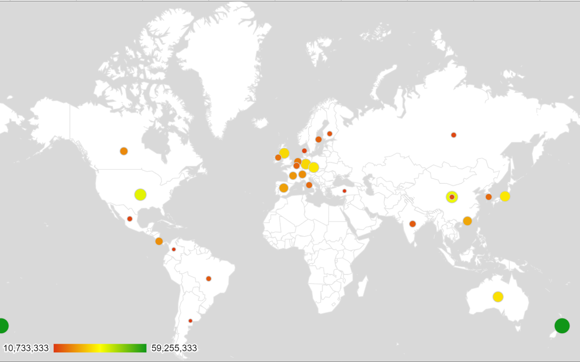
Distribution of supply chain
Notes:
Introduction
Display a geospatial map showing the distribution of the supply chain across the United States, Europe, and APAC.
Highlight the proportion of suppliers in each region with color-coded markers.

Slide 3
Insights on supplier distribution
Denmark – 15 %
Sweden – 15 %
Russian Federation – 15%
Notes:
Supply Chain Insights
Provide insights on supplier distribution in key regions:
United States: 45%
Europe: 30%
APAC: 25%

Slide 4
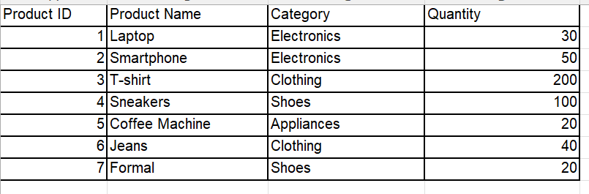
Products in Stock Table
Notes:
Products in Stock Table
Present a table showing product names, quantities, and availability across different categories.
Inventory Insights

Slide 5
Key Takeaways
Importance of strategic supply chain analysis for regional distribution
Benefits of intelligent inventory management based on inventory trends
Growth opportunities by recognizing regions with high demand potential

Slide 6
Conclusion
Enhance efficiency
Tailor strategies
Drive growth
Notes:
Conclusion
Conclude by underscoring the potential to enhance efficiency, tailor strategies, and drive growth through insights gained.

Slide 7
Q & A
Notes:
Invite questions and discussions to collaborate on refining supply chain and inventory strategies.

